Slide 1




BUILD YOUR BRAND
A Beginner’s Guide to Social Media Presence for Entrepreneurs
Lecture 2

Slide 2

Facebook Page
Log into your personal Facebook account.
DON’T: create a new Facebook account
Create a Facebook page for your company:
Click on 9-dot Menu icon -> Go to ‘Create’ Section → Select ‘Page Option’ -> Enter Page Name → Select Category → Click Create Page → Add Profile Photo → Add Cover Photo → Save/Next.
Desktop link: https://www.facebook.com/business/tools/facebook-pages/get-started/

Slide 3
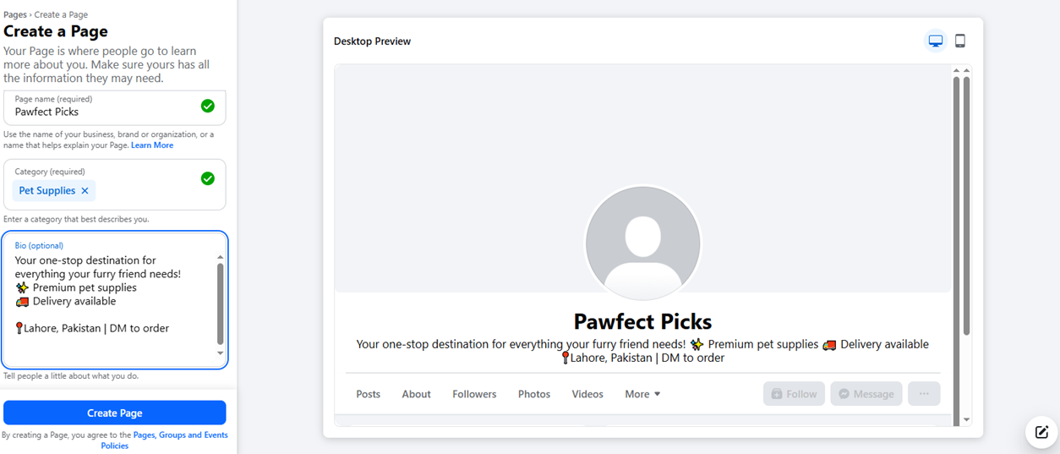

Slide 4
Instagram Business Page
Open instagram.com and click “Sign up”
Add profile picture and Bio
NOTE: Can only change to business profile on mobile
Click your profile picture and go to Settings (gear icon ⚙️ or the menu ≡)
In the search bar, type: Switch to professional account
Select Business (not “Creator”) and choose category (e.g., Bakery, Clothing, Artist)
Add your contact info (email, phone, WhatsApp if you want)

Slide 5
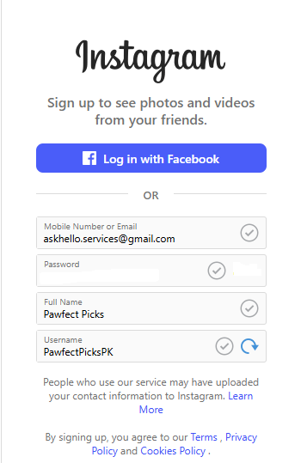
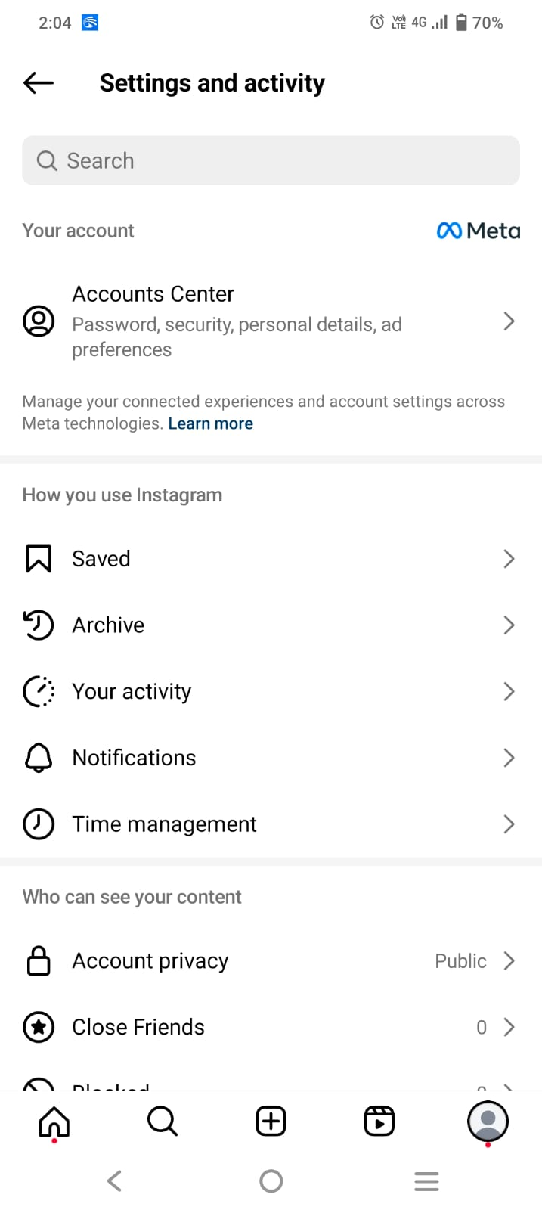
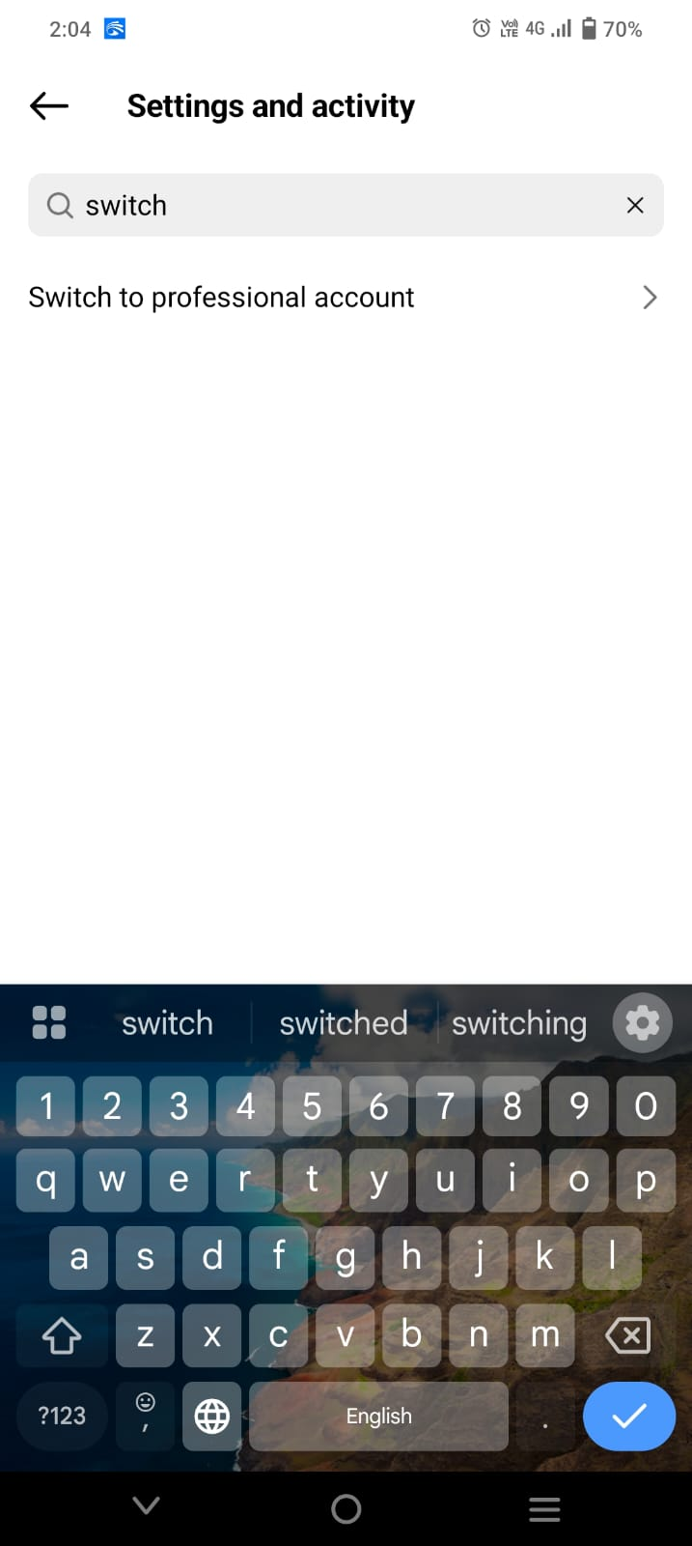
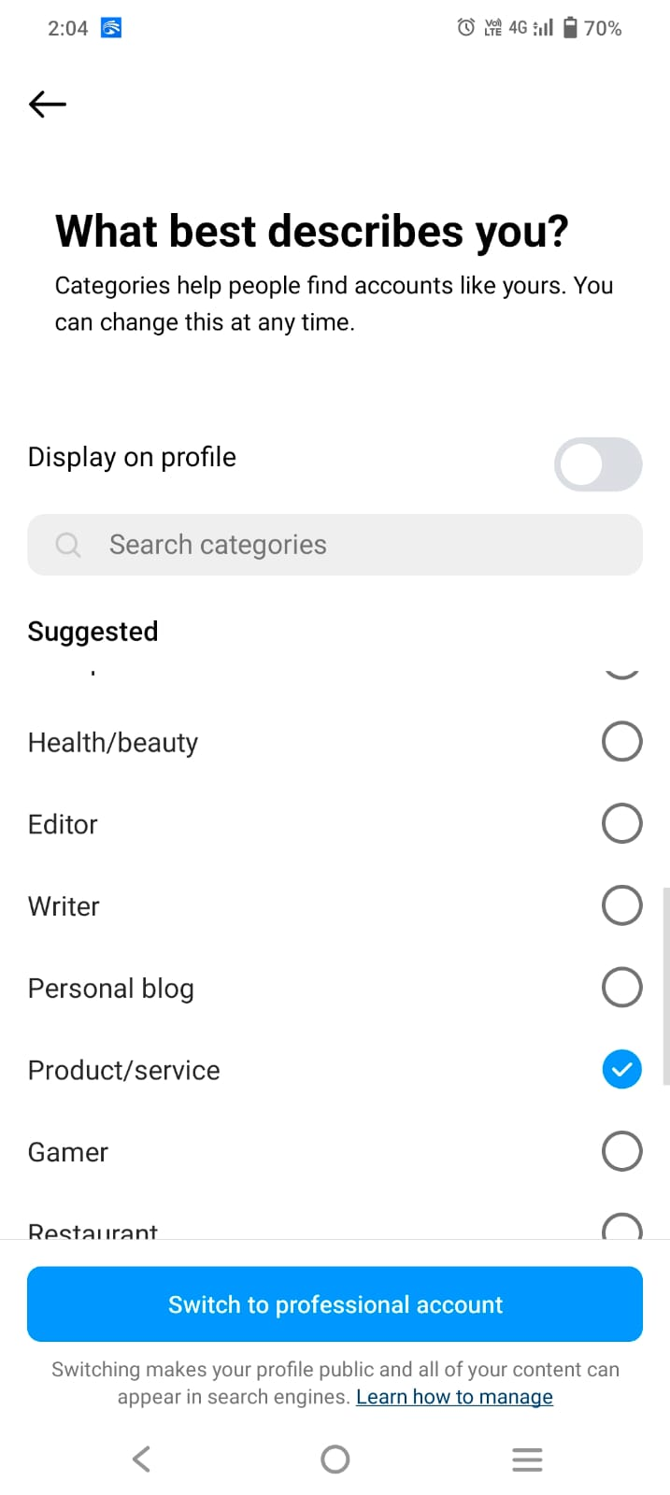
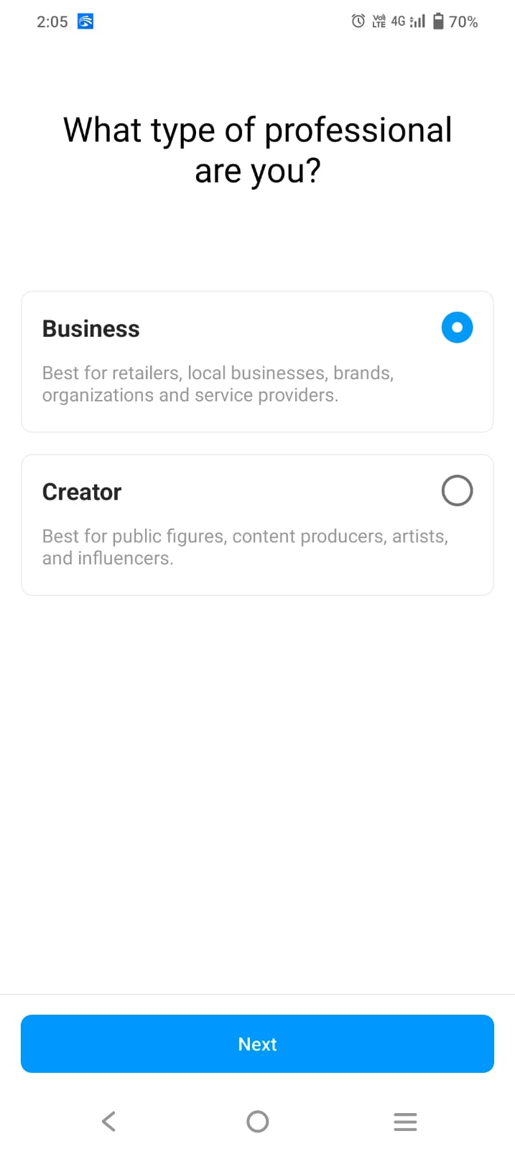
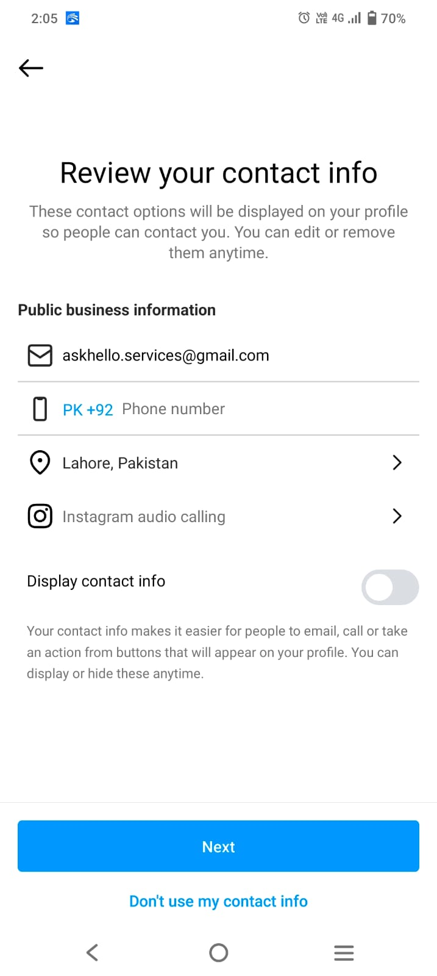

Slide 6
Link both accounts
Facebook.com → Switch to Page → Professional Dashboard → Linked Accounts → Instagram → Connect Account → Log in → Allow.

Slide 7
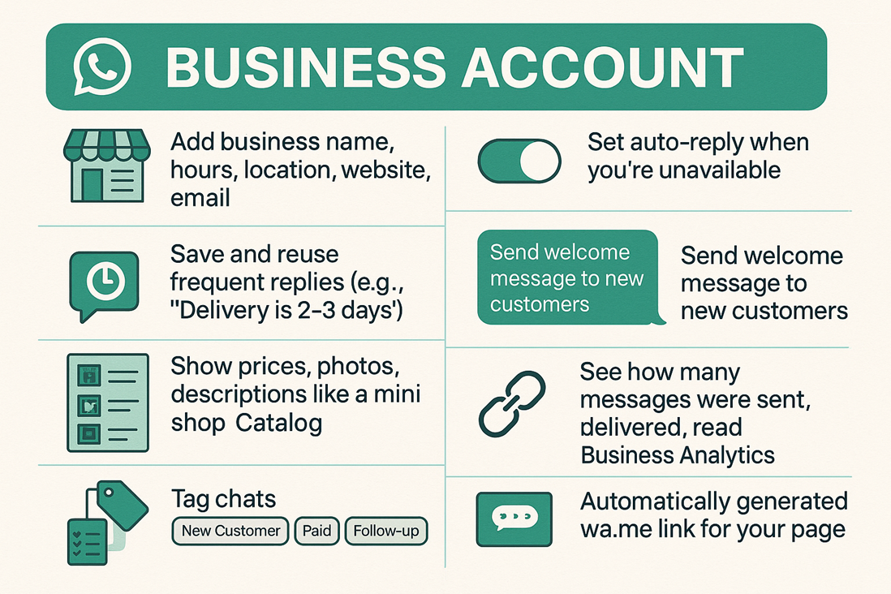
WhatsApp Business
WhatsApp communities can be used to give information

Slide 8
WhatsApp Business
Download “WhatsApp Business” from Play Store/App Store
Choose to use your existing number or a new one
Set up your Business Profile (name, description, working hours, email, etc.)
Data can be migrated without any loss

Slide 9
WhatsApp Integration
Go to: https://create.wa.link/
Enter details, download the QR code and copy the link
Go to your Facebook Page
Click the “+ Add Action Button” under your cover photo
Choose “Send WhatsApp Message” and enter your WhatsApp number
Facebook will send you a code via WhatsApp to confirm
Once verified, a “Send WhatsApp” button appears

Slide 10
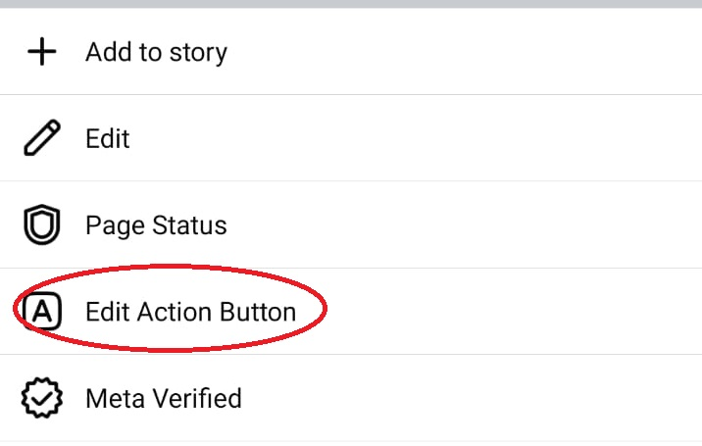
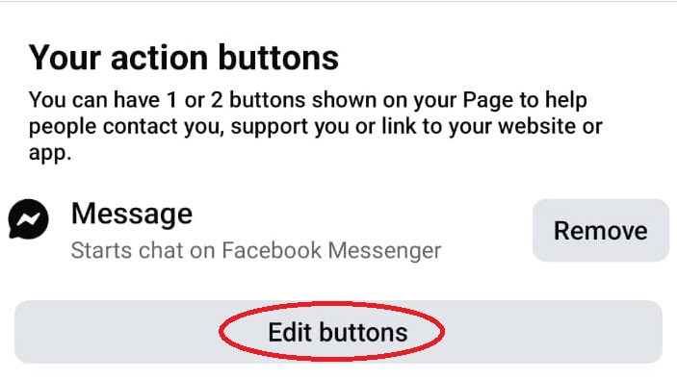
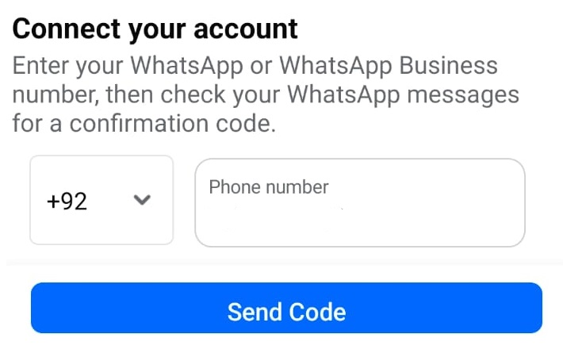
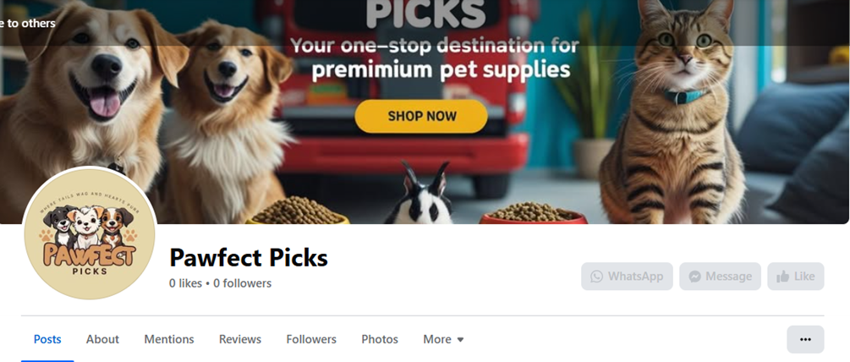
WhatsApp Integration

Slide 11
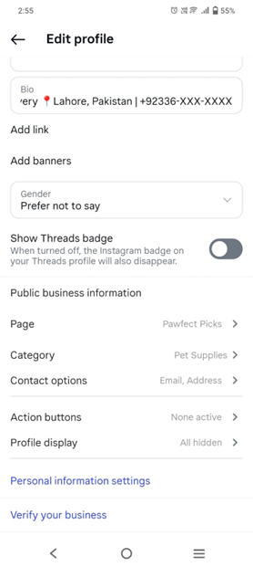
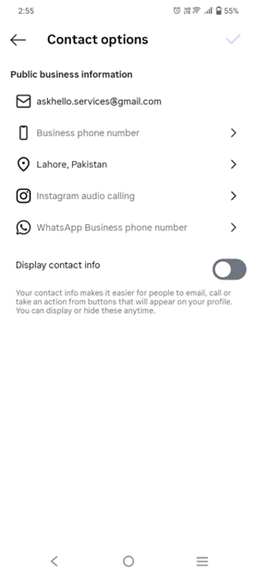
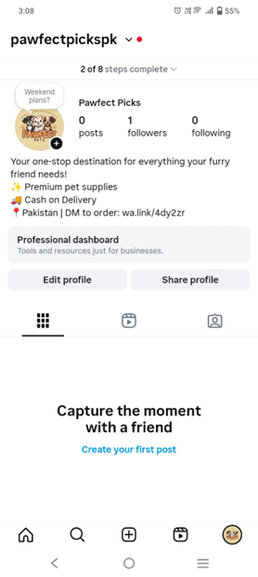
WhatsApp Business
Add WhatsApp business number OR paste link in bio
Need a WhatsApp Business number to make a button

Slide 12
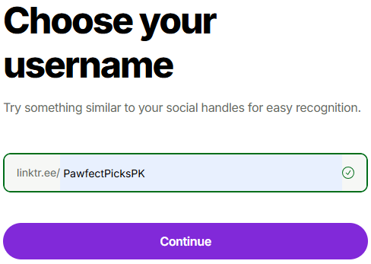
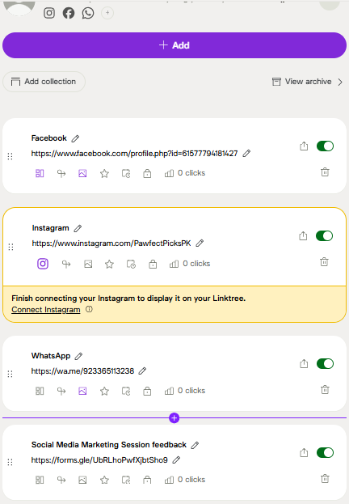
Linktree Integration
Open https://linktr.ee/→ Sign up for free → email → username (similar to your Instagram handle)
Select your account type and category → Select free account
Select Facebook and Instagram
Add more links
Copy your LinkTree URL
Edit your Instagram profile → Add Links → paste your linktree URL

Slide 13
Instagram Quick Replies
On your business profile, tap the hamburger menu (≡)
Open "Business tools and controls"
Open "Saved replies" → "+"
eg: Shortcut: thankyou
eg: message: "Thank you for reaching out! We'll get back to you shortly."
Save
To use quick replies:
Type / followed by your shortcut → send
/thank

Slide 14
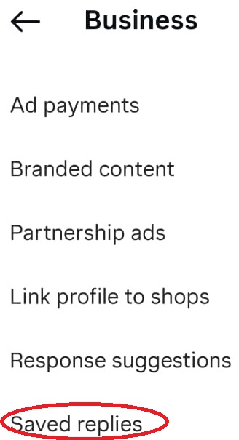
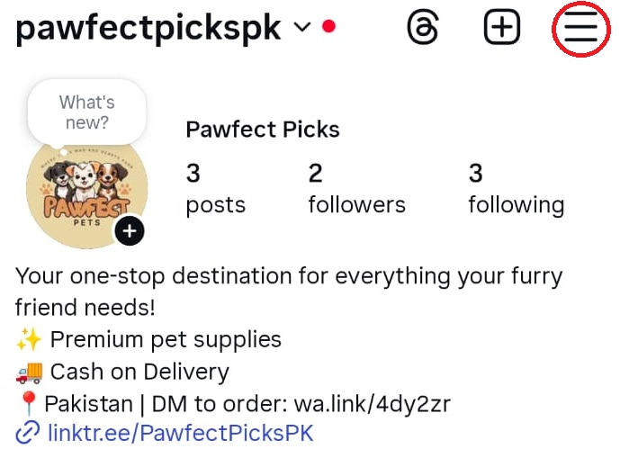
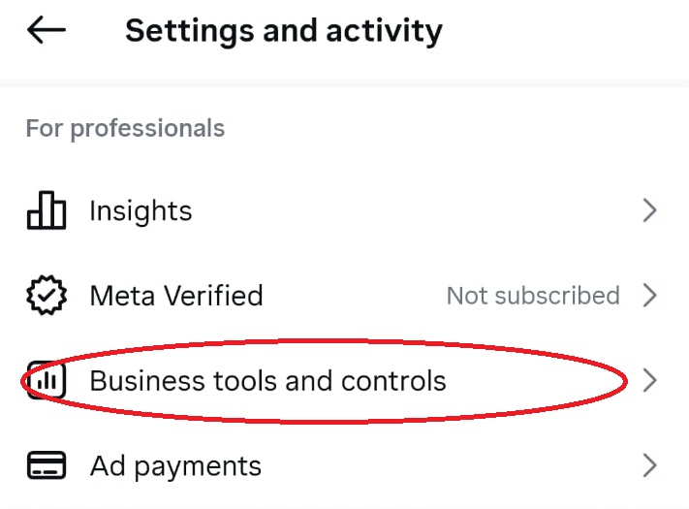
Instagram Quick Replies

Slide 15
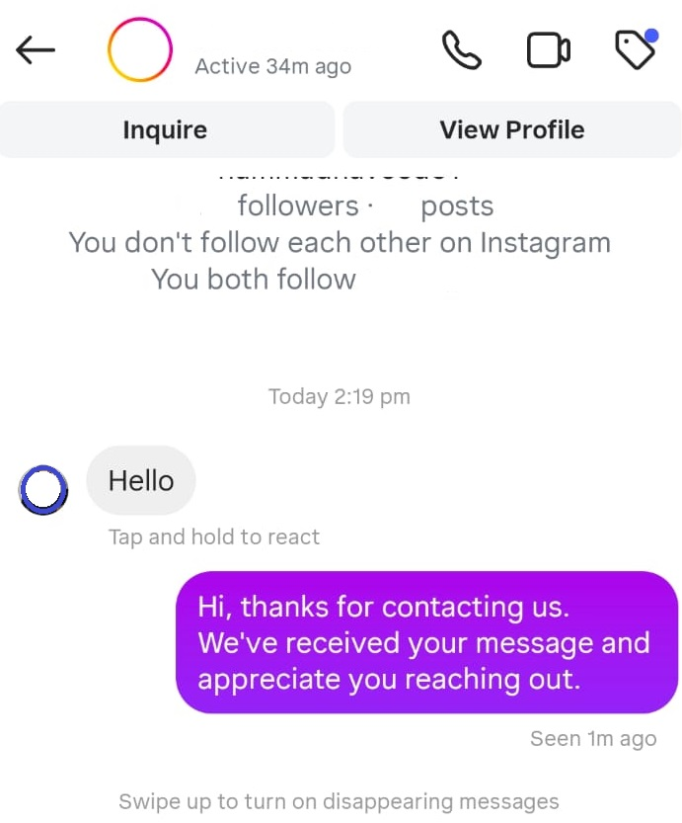
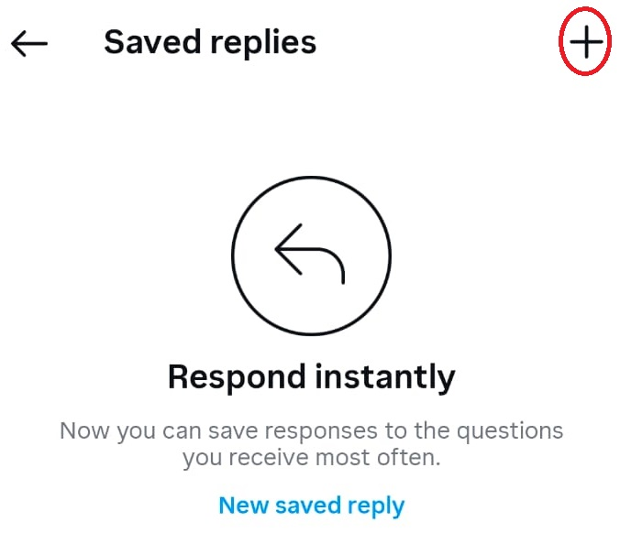
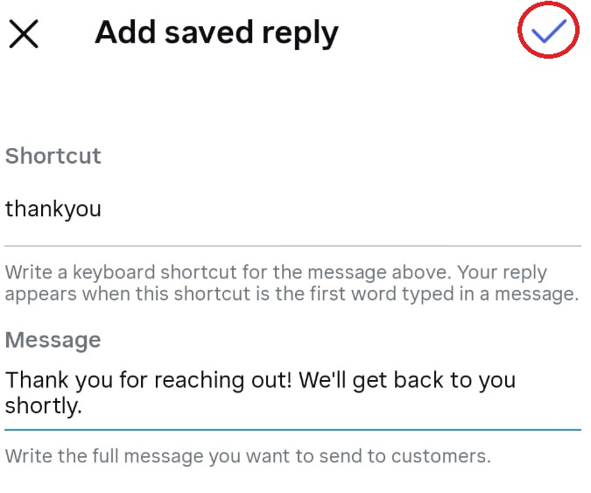
Instagram Quick Replies

Slide 16
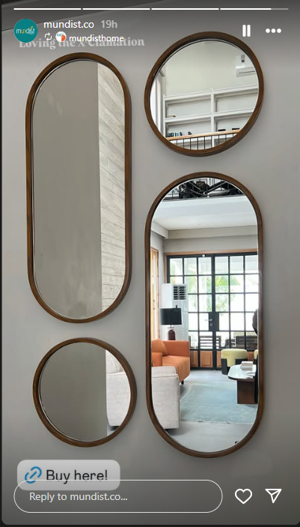
Add links
Can direct to Link in Bio on posts, reels and stories
Use Link sticker in stories

Slide 17
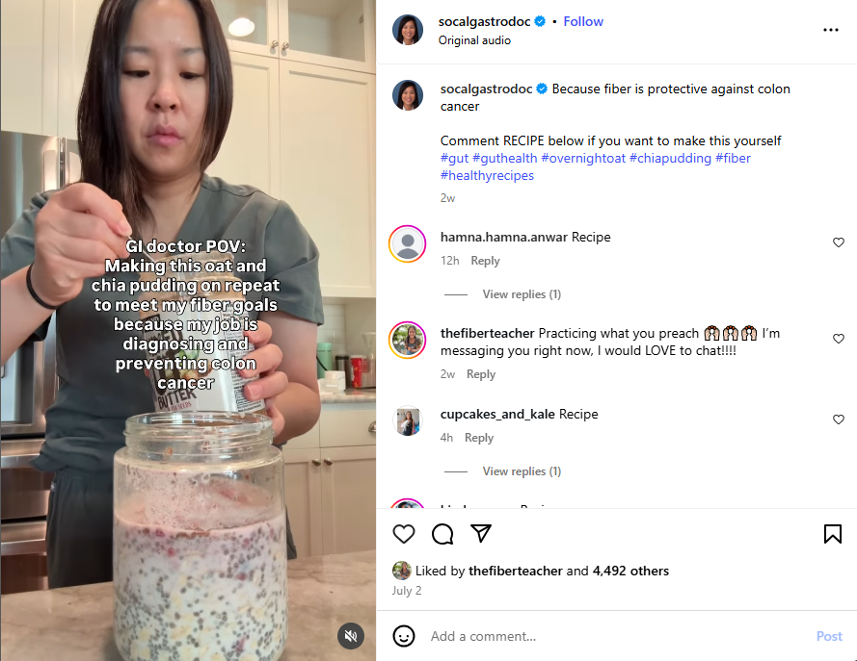
Add links
Ask to comment a word can be used in stories only

Slide 18
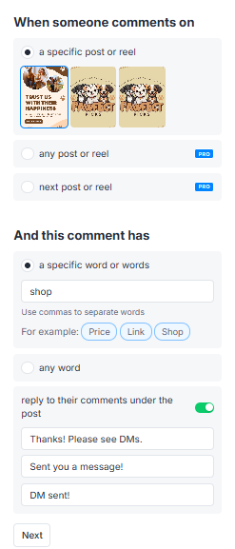
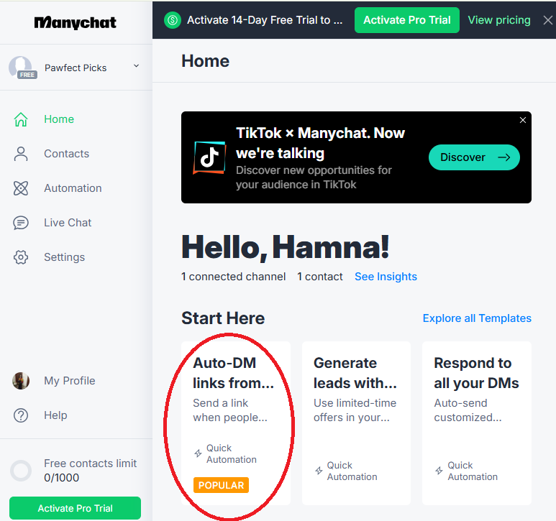
ManyChat integration
Open https://manychat.com/ → sign up with email
Link with Meta Business Suite → stepwise link Facebook and Instagram

Slide 19
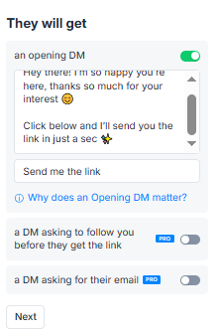
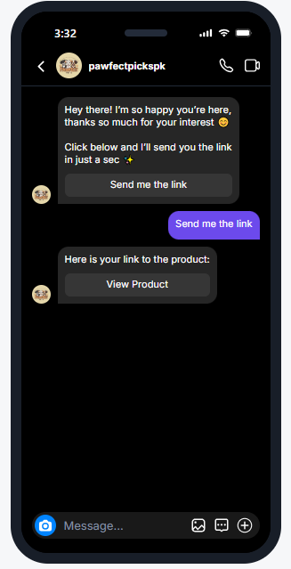
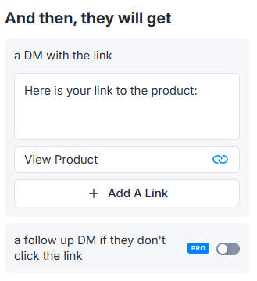
ManyChat integration
Click on “Go Live”

Slide 20
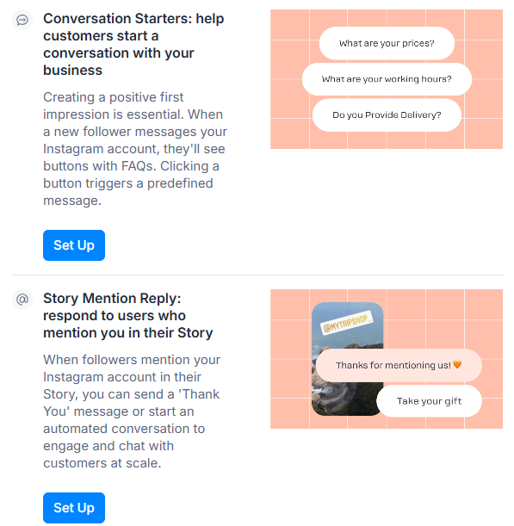
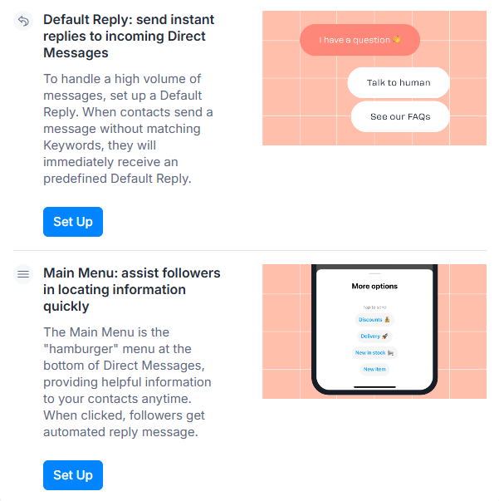
ManyChat integration

Slide 21
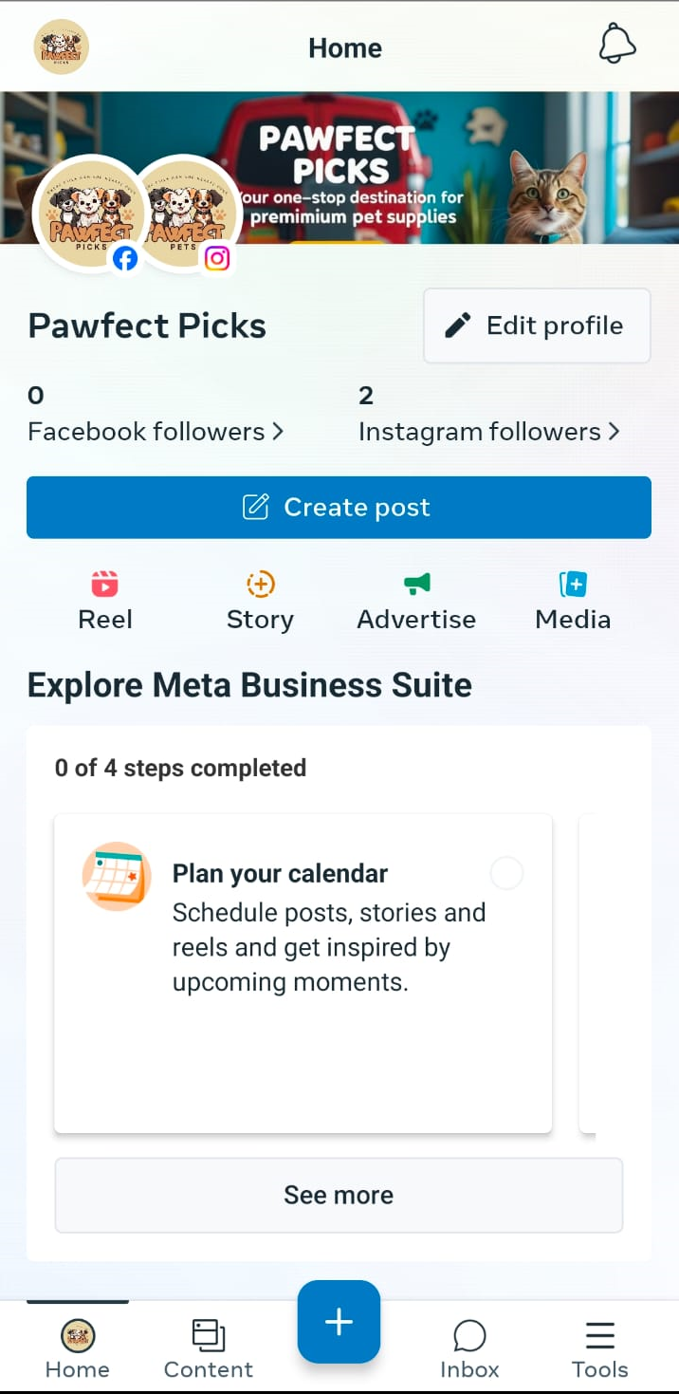

Meta Business Suite
Option 1: Download Meta Business Suit app from App Store and log in

Slide 22
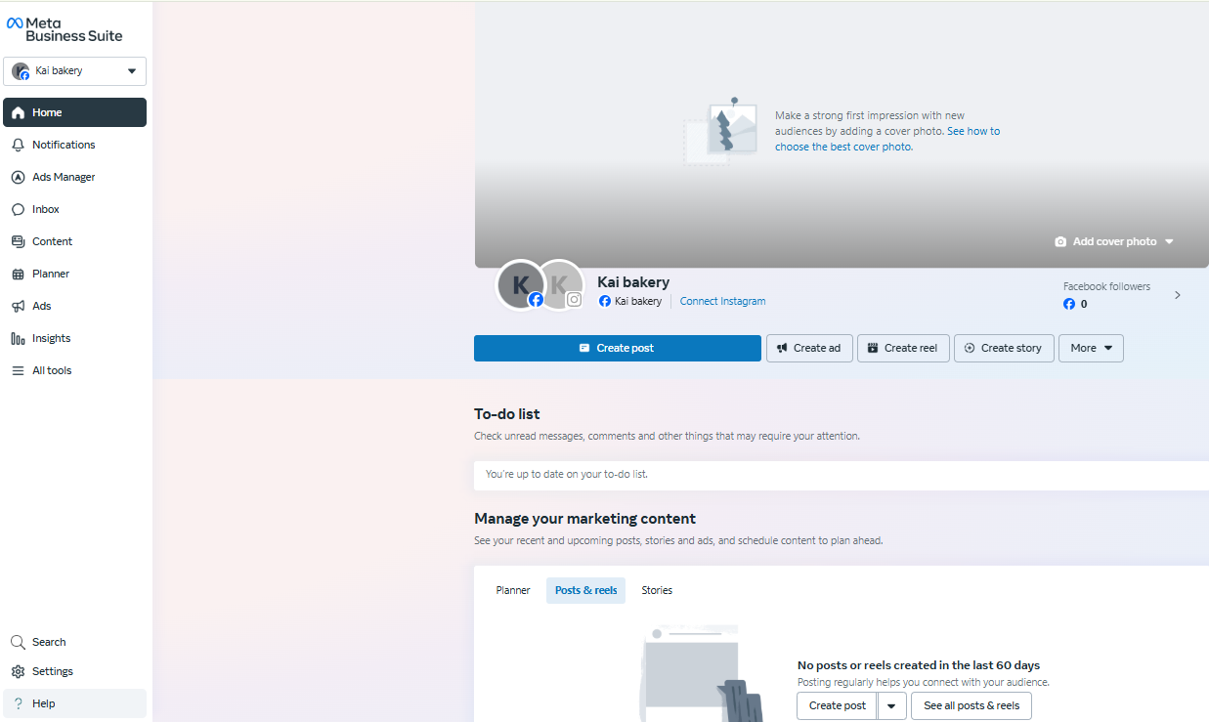
Meta Business Suite
Option 2: Desktop: https://business.facebook.com/

Slide 23
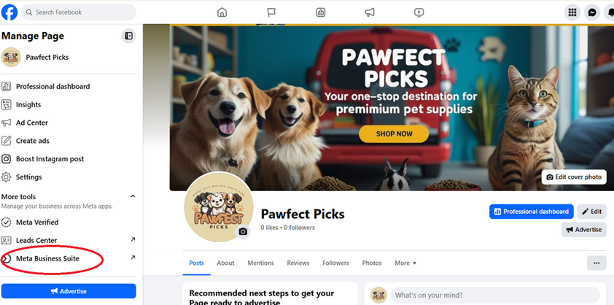
Meta Business Suite
Option 3: Navigate to your Facebook Page

Slide 24
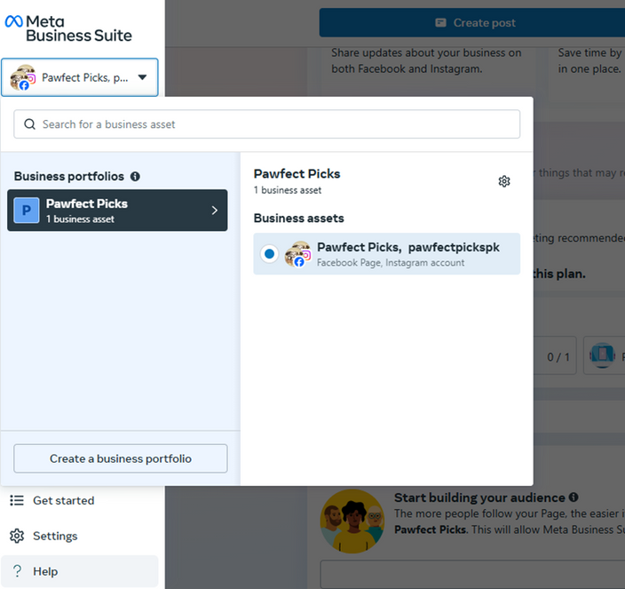
Meta Business Suite
Create OR select a business portfolio
Name (same as business name) & email
Give your First Name and Last Name as on CNIC
Connect your Instagram account

Slide 25
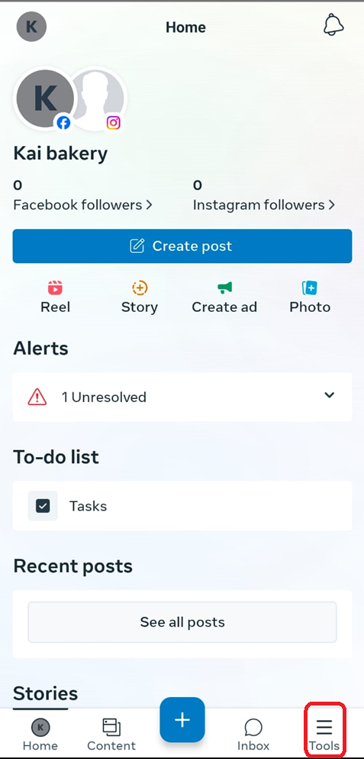
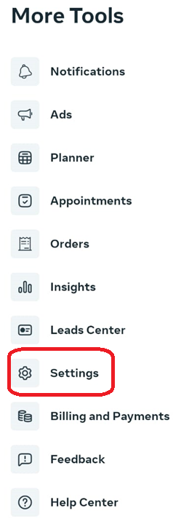
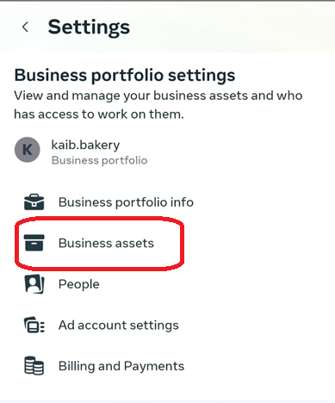
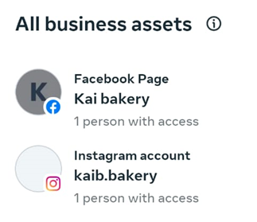
Meta Business Suite

Slide 26
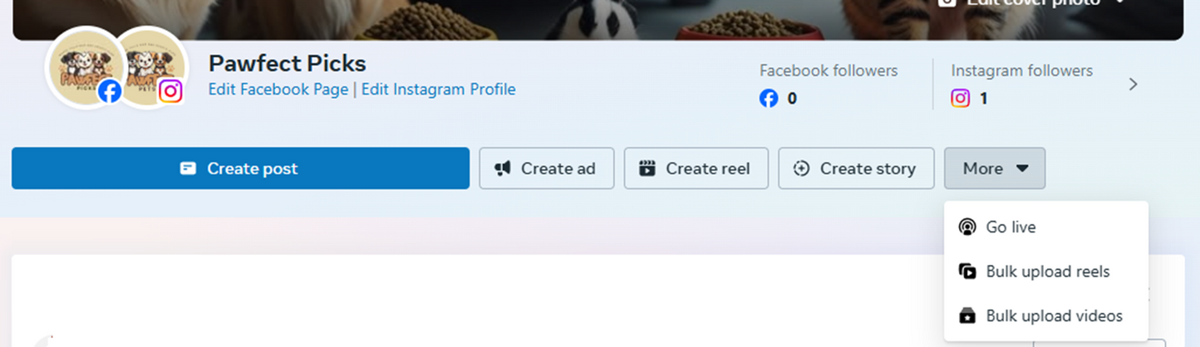
Meta Business Suite
Hands-on showing the Meta Business Suite: Home, Content, Inbox, Planner, Insights, and Ads tabs.
Insights
Professional Dashboard

Slide 27
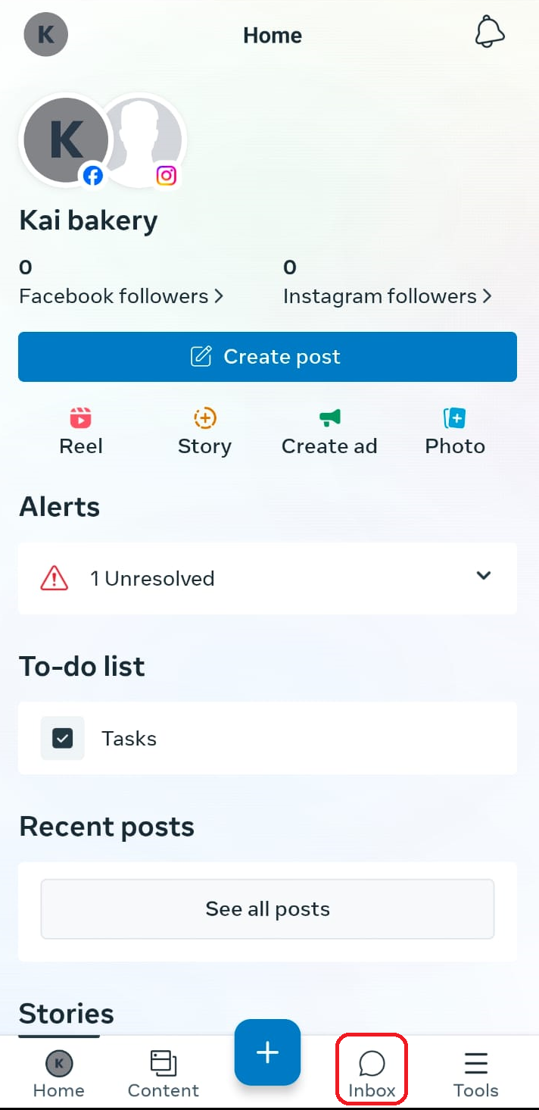
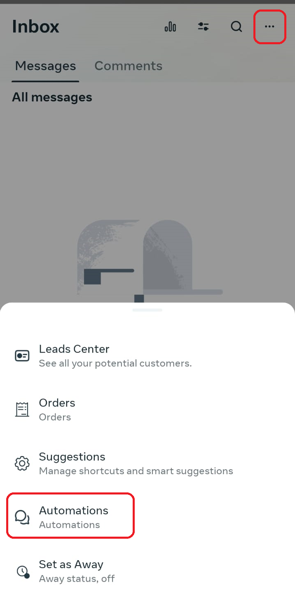
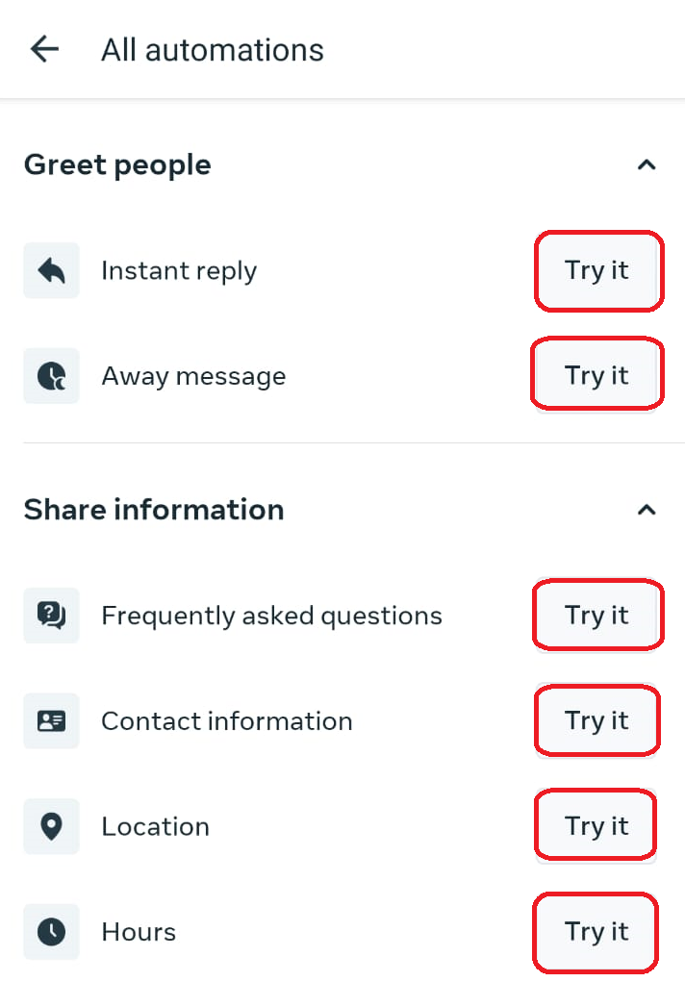
Meta Business Suite
Automation
Inbox → Automations

Slide 28
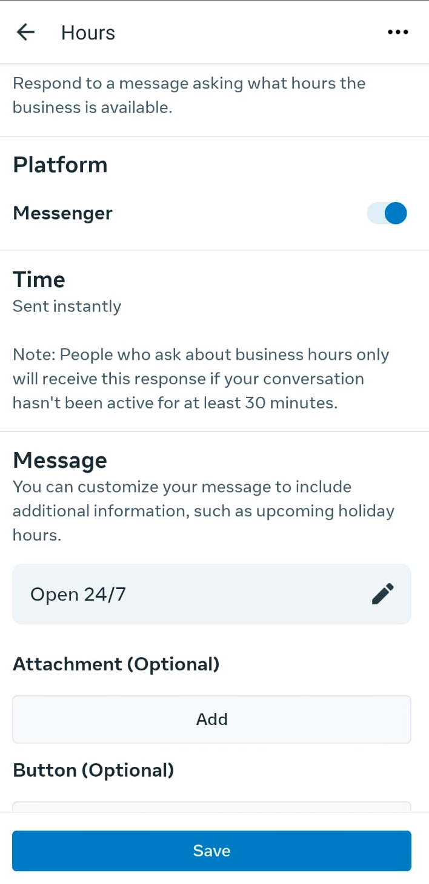
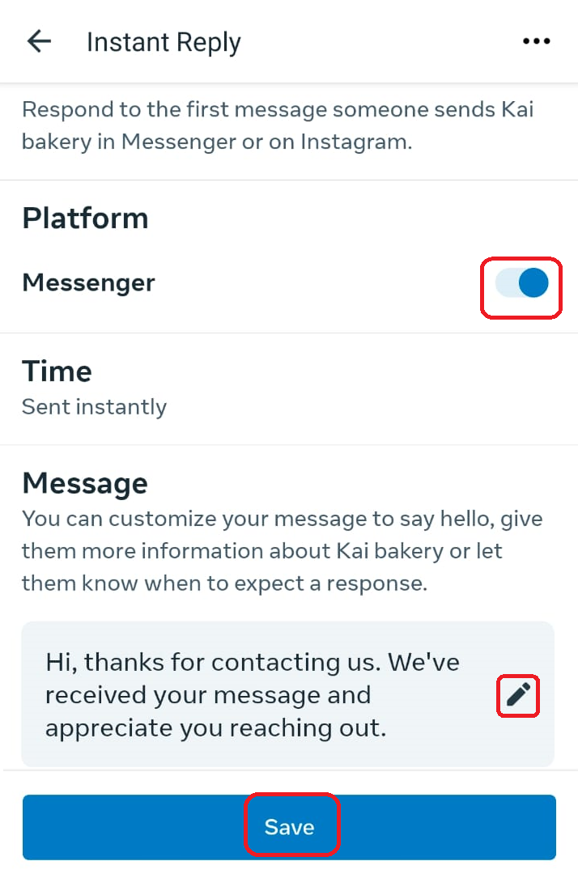
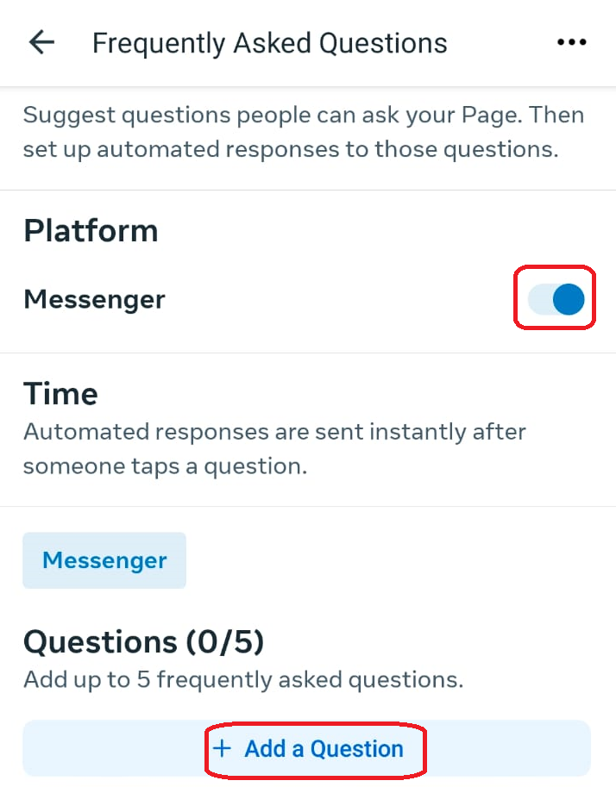
Meta Business Suite
Automation
Inbox → Automations

Slide 29
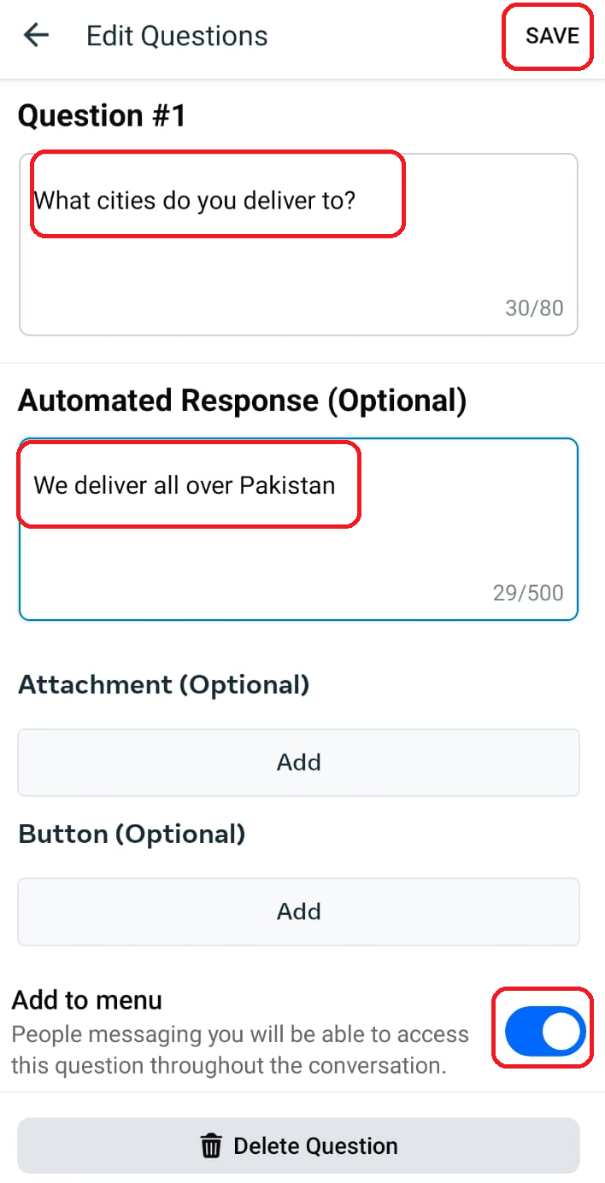
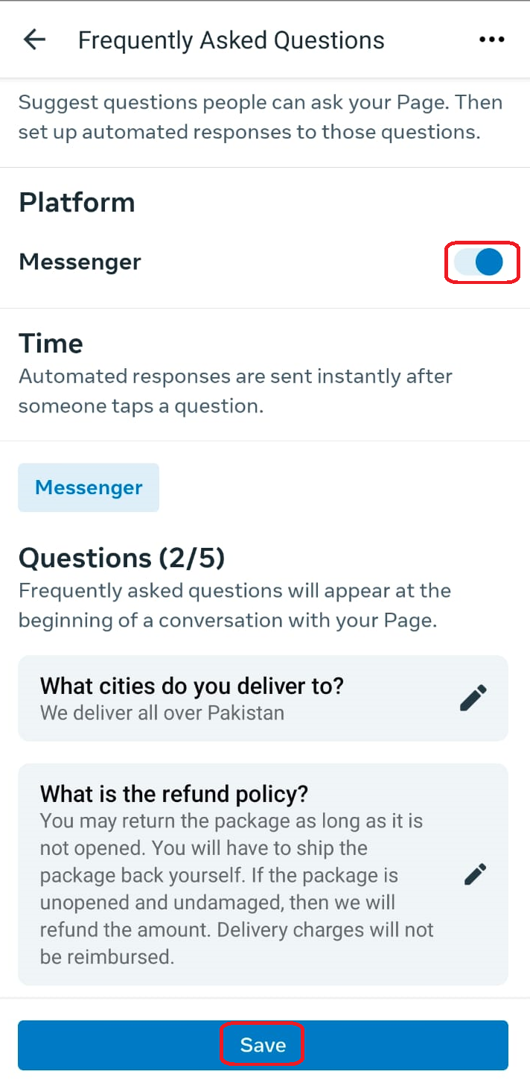
Meta Business Suite
Automation
Inbox → Automations

Slide 30
SCHEDULING
OF
POST

Slide 31
Meta Business Suite
Schedule a post
Create a reel on Canva and schedule a reel
Search for “Canva reel generator” or open https://www.canva.com/create/reels/

Slide 32
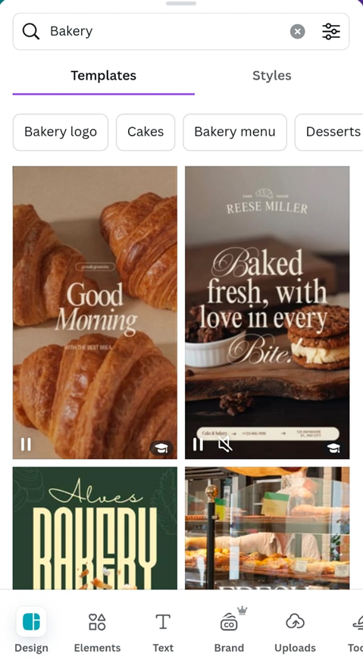



Meta Business Suite
Using Canva to create reels:

Slide 33



Meta Business Suite
Using Canva to create reels:

Slide 34



Meta Business Suite
Boost ads (simpler, but can’t target audience in a detailed manner)
Need to create an Ad account first and add payment information (will explain under paid ads)

Slide 35


Meta Business Suite
Boost ads (simpler, but can’t target audience in a detailed manner)
Need to create an Ad account first and add payment information (will explain under paid ads)

Slide 36





Paid ads

Slide 37
Paid ads
Need a credit or debit card for payments
Create a New Ad Account
Open settings in the Meta Business Suite business.facebook.com (desktop only)
Click Accounts → Ad Accounts → “Add” button → “Create a New Ad Account.”
Fill in details:
-Ad Account Name → e.g., "Kaib Bakery Ads“
-Time zone & currency (cannot be changed later)
-Assign yourself the role Admin so you can manage and run ads.
-Add a payment method (Master Card, Visa, Sadapay)
-Once done, you’ll see the ad account in your Meta Business Suite.
Notes:
Avoid audience overlap
Avoid auction overlap

Slide 38


Paid ads
Add further details
Notes:
Avoid audience overlap
Avoid auction overlap

Slide 39

Paid ads
Download Meta Ads Manager from the App Store for the hands-on activities
Many deep asset assignments not possible on mobile app
Desktop: https://adsmanager.facebook.com/
Ads: Images, videos, text
Ad sets: has a collection of ads with the same settings
Campaigns: collection of ad sets with specific goal
Notes:
Avoid audience overlap
Avoid auction overlap

Slide 40
End of Lecture

